Slide 1

Code Green
Hacking on Amazon Sustainability Data Initiative datasets
John McGrath, AWS Sustainability
1/28/2020
Notes:
Thank you [to sustainability introducer, if present], and welcome everyone to Code Green. I’m [your name], a [whatever you are] at AWS. This is a workshop originally developed to accompany the Code Green Hackathon at re:Invent 2019, which we’re now doing as a standalone event. I’m going to take a moment to describe what we’ll be doing today—the data we’ll be using, the AWS services we’ll be using, and the somewhat constructed scenario we’ll use to imagine how one might put these together.

Slide 2
Amazon Sustainability Data Initiative
Part of Registry of Open Data on AWS
54+ datasets: geodata, climate, weather, species, more
Maintained by partners
Docs and usage examples
https://registry.opendata.aws/tag/sustainability/
Notes:
Many if not most sustainability solutions are built on top of data—sometimes this is proprietary data, like maybe sensor data from devices you own or control, but often they’re built on, or include, public data sets. To help foster work in sustainability Amazon hosts dozens of public datasets via the Amazon Sustainability Data Initiative, part of the AWS Public Dataset program. These datasets are provided and maintained by partners such as NOAA, Planet, Sinergize, Mapzen, and others, and hosted for free on AWS, and made available for free to the public.
You can go to the URL here and view the full list of datasets. For today’s workshop we’re going to be focusing on one dataset in particular…

Slide 3
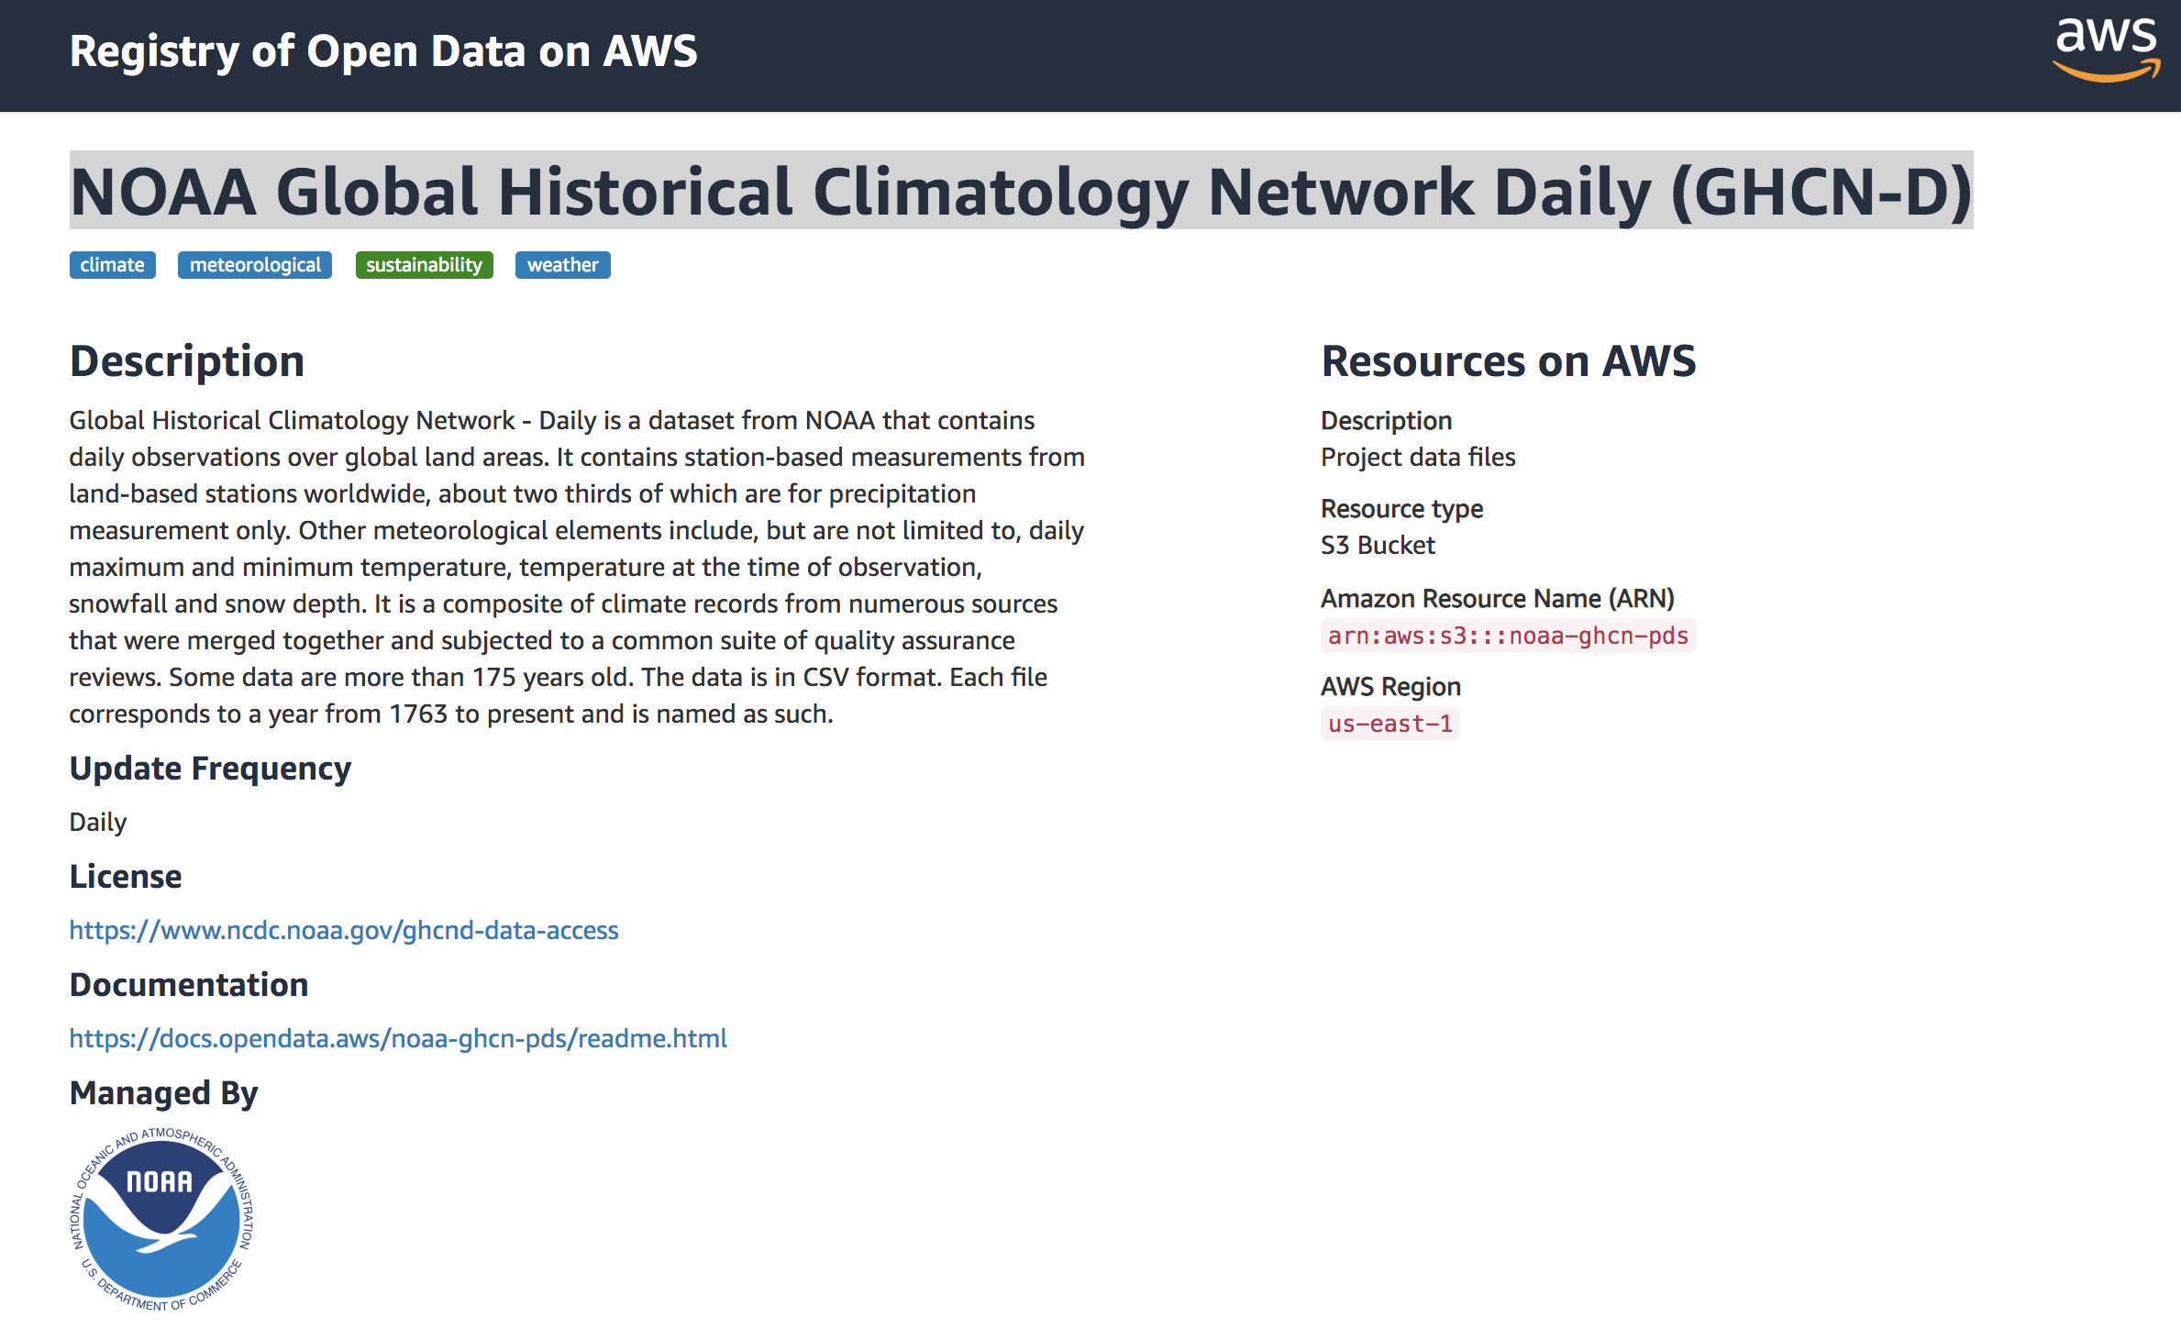
NOAA GHCN-D
https://registry.opendata.aws/noaa-ghcn/
Notes:
The Global Historical Climatology Network – Daily, aka GHCN-D, is a dataset from NOAA that contains daily climate observations over global land areas, some going back to the mid nineteenth centure. It contains data like daily max and min temperature, precipitation, snowfall, and other observations where available. Our project today is going to be based on querying GHCN-D data hosted by AWS, doing some calculations, and then exposing it to the user via an API and a little web application.

Slide 4
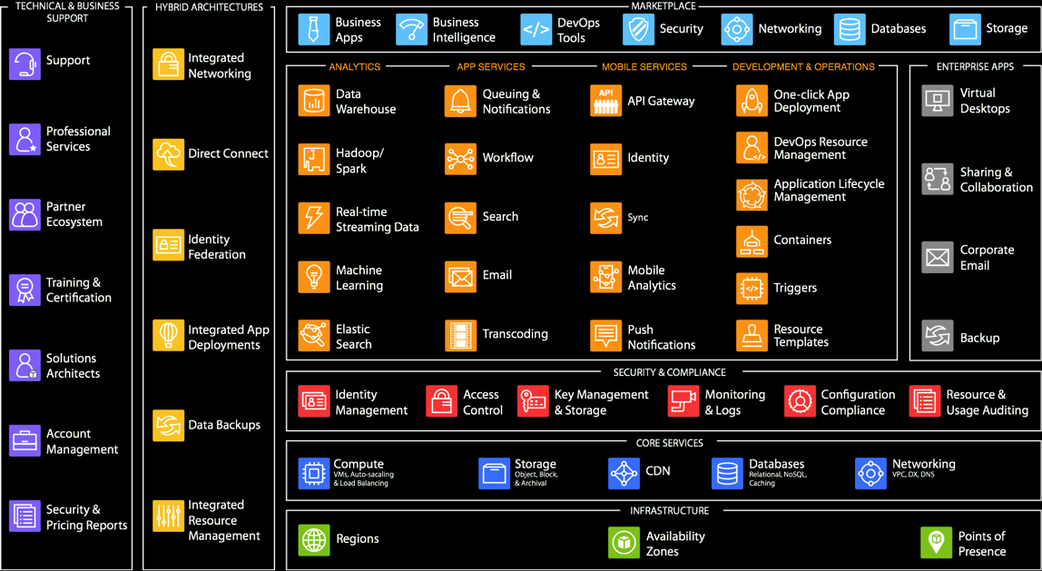
AWS: lots of options
Notes:
We’re going to use AWS services to do this. No, we’re not going to use all these services. This is not meant to be intelligible, just to illustrate, we have a lot of services—it’s the blessing but also sometimes the curse of AWS, it can be hard to know where to begin. I mean, this isn’t even a list of services, it’s categories of services, like one of those boxes is “Databases”—behind that we actually have nine different purpose-built databases, each with many variants and features. Which is just to say, it’s a lot.

Slide 5
So for today…
Amazon S3 object storage
Amazon Athena query static files in S3 with SQL
AWS Glue perform ETL and catalog data
AWS Lambda run event-driven code without servers
Amazon API Gateway create API endpoints & mappings
Amazon S3 redux web server for static files
Notes:
This workshop focuses on just a handful of the core services that are often used to store, query, and manipulate big data sets, to give you a taste of how these kinds of data-backed sustainability solutions can be built. The six services we’ll be using are:
S3, Amazon’s highly, highly scalable storage service that I’m sure many of you have heard of or used. ASDI data is all stored in S3 “buckets,” as S3 storage areas are called, and it can be accessed programattically via SDK or CLI from, basically, anywhere.
Athena is a service that lets you query data in S3 using SQL, much as if it were in a relational database. Which feels magical if you’re used to having to go through arduous processes to load data into relational databases in order to query it.
Glue lets you do “Extract, Transform, Load” jobs, and also is a catalog service which lets you define the data you have stored in S3. It has some overlap with Athena, and we’ll take a look at how it can do some of the same things.
Lambda simply lets you run code in response to events. It lets you perform computation without having to set up your own servers, so it’s often called a “serverless” service.
API Gateway lets you define, wait for it… APIs! Which we’ll need in order to power the web app we’re going to build to see the results of the our little service we’ll be building.
And then, on top, we’re going to build a very simple html application. S3 buckets can be configured as web servers, so we’ll do that, sort of ending where we began in S3.
Let’s talk about what we’re actually going to do with these…

Slide 6
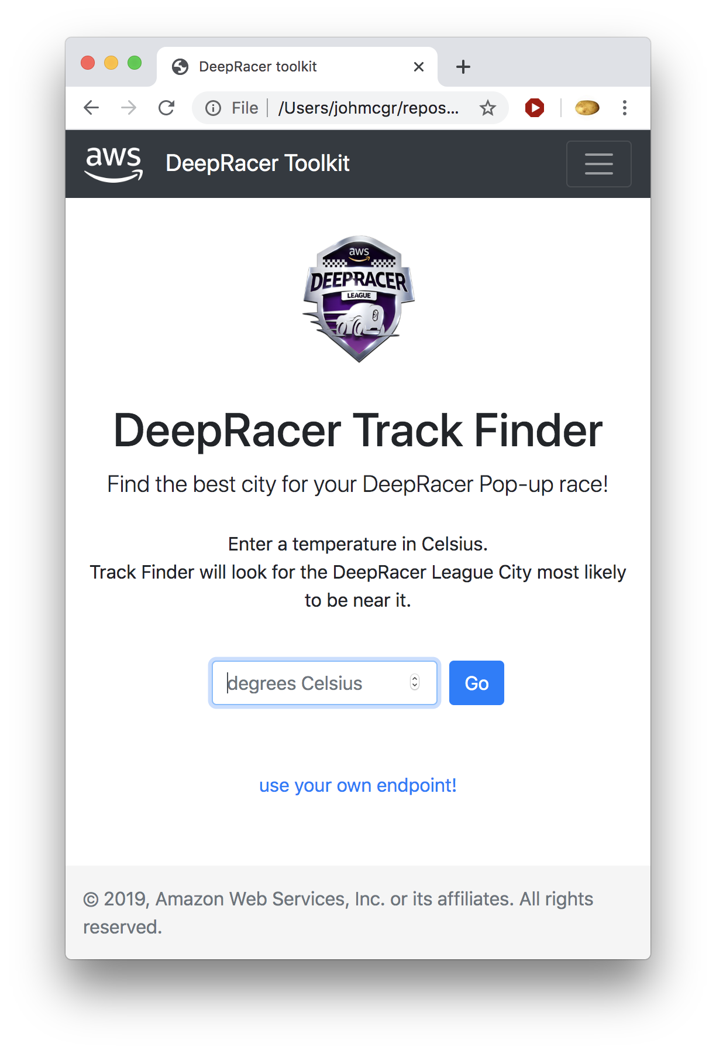
The application
An app to find the most sustainable location for an event.
Determined by local weather
Query GHCN-D data for each possible location, pick the best one
A non-naive solution would use a lot more data: travel info, power generation, etc
Notes:
so this is what we’ll do. now, back to the services involved

Slide 7
Spelling it out…
A user views the website on Amazon S3, which calls…
Amazon API Gateway which maps the call to…
AWS Lambda which queries tables created in…
AWS Glue and runs the query using
Amazon Athena against ASDI data residing in
Amazon S3. The results are returned to the Lamba, which sends them to the app in the API Gateway response.
Notes:
This workshop focuses on just a handful of the core services that are often used to store, query, and manipulate big data sets, to give you a taste of how these kinds of solutions can be built. The six services we’ll be using are:
S3, Amazon’s highly, highly scalable storage service that I’m sure many of you have heard of or used. ASDI data is all stored in S3 “buckets,” as S3 storage areas are called, and it can be accessed programattically via SDK or CLI from, basically, anywhere.
Athena is a service that lets you query data in S3 using SQL, much as if it were in a relational database. Which feels magical if you’re used to having to go through arduous processes to load data into relational databases in order to query it.
Glue lets you do “Extract, Transform, Load” jobs, and also is a catalog service which lets you define the data you have stored in S3. It has some overlap with Athena, and we’ll take a look at how it can do some of the same things.
Lambda simply lets you run code in response to events. It lets you perform computation without having to set up your own servers, so it’s often called a “serverless” service.
API Gateway lets you define, wait for it… APIs! Which we’ll need in order to power the web app we’re going to build to see the results of the our little service we’ll be building.
And then, on top, we’re going to build a very simple html application. S3 buckets can be configured as web servers, so we’ll do that, sort of ending where we began in S3.
Let’s talk about what we’re actually going to do with these…

Slide 8
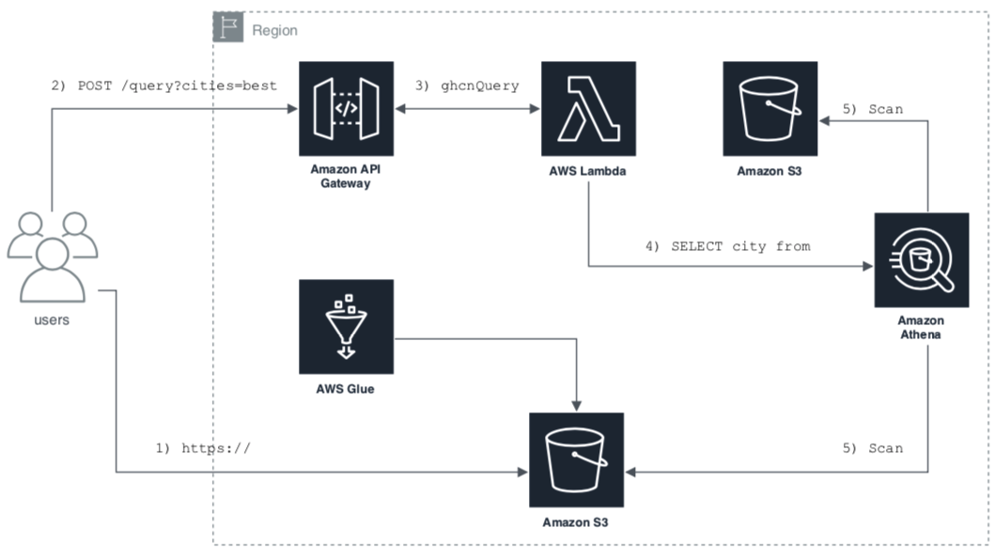
For you visual learners:
Notes:
This workshop focuses on just a handful of the core services that are often used to store, query, and manipulate big data sets, to give you a taste of how these kinds of solutions can be built. The six services we’ll be using are:
S3, Amazon’s highly, highly scalable storage service that I’m sure many of you have heard of or used. ASDI data is all stored in S3 “buckets,” as S3 storage areas are called, and it can be accessed programattically via SDK or CLI from, basically, anywhere.
Athena is a service that lets you query data in S3 using SQL, much as if it were in a relational database. Which feels magical if you’re used to having to go through arduous processes to load data into relational databases in order to query it.
Glue lets you do “Extract, Transform, Load” jobs, and also is a catalog service which lets you define the data you have stored in S3. It has some overlap with Athena, and we’ll take a look at how it can do some of the same things.
Lambda simply lets you run code in response to events. It lets you perform computation without having to set up your own servers, so it’s often called a “serverless” service.
API Gateway lets you define, wait for it… APIs! Which we’ll need in order to power the web app we’re going to build to see the results of the our little service we’ll be building.
And then, on top, we’re going to build a very simple html application. S3 buckets can be configured as web servers, so we’ll do that, sort of ending where we began in S3.
Let’s talk about what we’re actually going to do with these…

Slide 9
Get started!
Go to: http://j.mp/code-green-workshop
Read to ‘setup,’ click ‘Start here’
You’re off!
Notes:
So, now what we know we’re after, let’s work backwards…
Users will use an app, hosted in S3. The app will hit an API built with API Gateway. Calls to the API Gateway will trigger a Lambda to run. The Lambda will use Athena to query tables created using Athena and Glue. Those tables describe data held in S3, so when that query is run, that’s where the results will come from. And that Lambda will get the results, and send a response back through the gateway, back to the user’s application.

Slide 10
Divider slide
Subtitle

Slide 11
Thank you

